Slide 1


ANALYSIS
ON
AMAZON PRODUCT REVIEW DATA
Using Natural Language Processing
Meghana Shivani Gogu - M.E. (Manufacturing) | Sagar Barkam - B.Tech (Mechanical Engineering)

Slide 2
Introduction

Slide 3
Objective
Perform Sentiment Analysis on Amazon Review Text Data to Understand Customer Needs and Opinions, and Build an Effective Model using Machine Learning Algorithms

Slide 4
Project Lifecycle
Understanding Data
Data Preparation
EDA
Model Building
Model Prediction
Model Evaluation

Slide 5
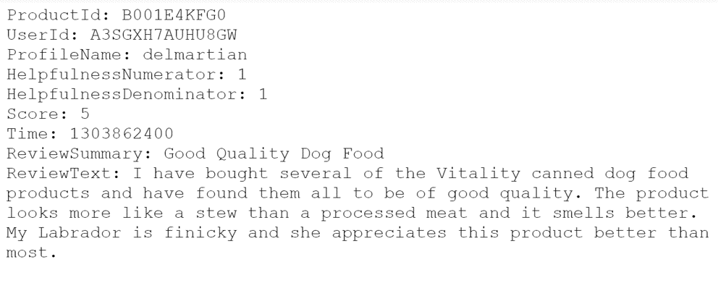
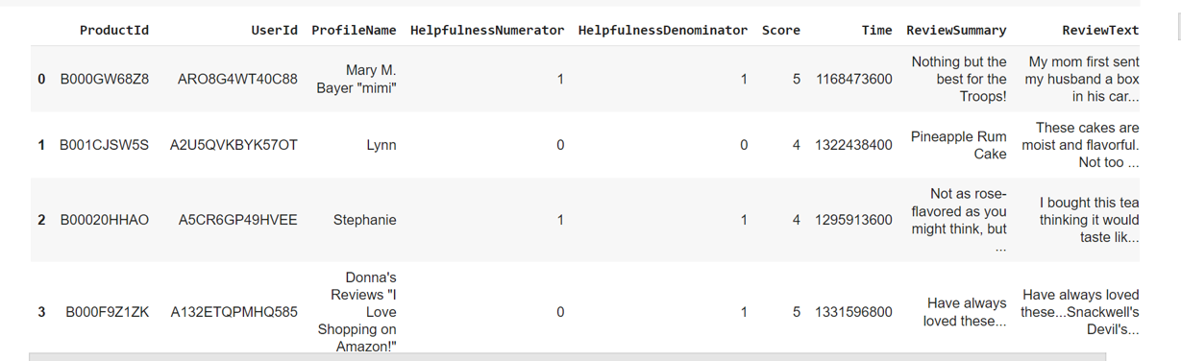
Data
Extraction of 5,68,454 text files from Zipped folder Data observations | Creation of DataFrame Transformation of Data to tabular format (.csv)
BEFORE
AFTER

Slide 6
Understanding Data
Number of reviews: 5,68,454
Number of users: 2,56,059
Number of products: 74,258
Timespan: Oct 1999 — Oct 2012
Number of Features (columns) in data: 9
Features
ProductId
UserId
ProfileName
HelpfulnessNumerator
HelpfulnessDenominator
Score
Time
Summary
ReviewText

Slide 7
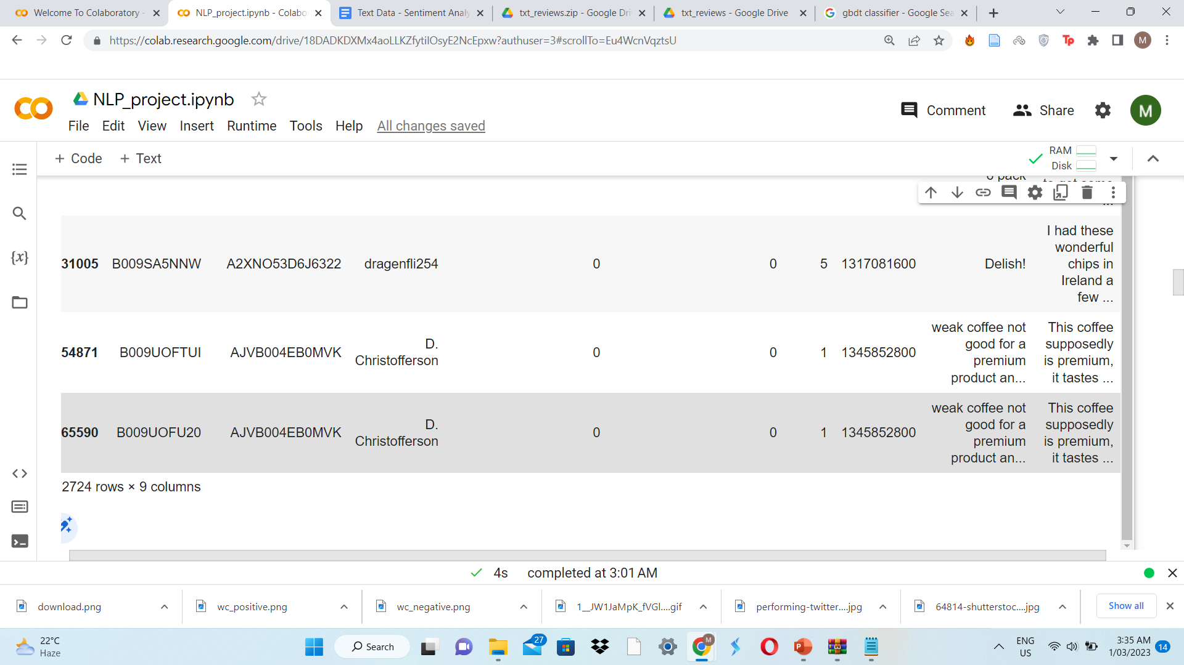
Data Cleaning
Import required libraries
Load the Data (.csv)
Duplicates
Sort
Drop
Missing values
Corrupted Data
Type conversion
(int to datetime)
Drop values where HelpfulnessNumerator > HelpfulnessDenominator

Slide 8



Review Classification
7.54%
Positive | Neutral | Negative
Score > 3 | Score = 3 | Score < 3
3,08,226 | 29,869 | 57,633

Slide 9
Data Preparation
Identification of Target variable
Segregation of inputs and output
Test-Train Split
Text Pre-processing – Lemmatization
1
2
3
4

Slide 10
Target Variable : Score
Input: ReviewText
Text Pre-Processing
PREREQUISITES Import nltk Download stopwords, wordnet, omw-1.4 Import re Import word_tokenize, stopwords, WordNetLemmatizer | PROCESS Special characters and digits removal Conversion to lowercase Tokenization into words Stop words removal Root words formation – Lemmatization

Slide 11
WordCloud
Positively Reviewed Data
Negatively Reviewed Data

Slide 12
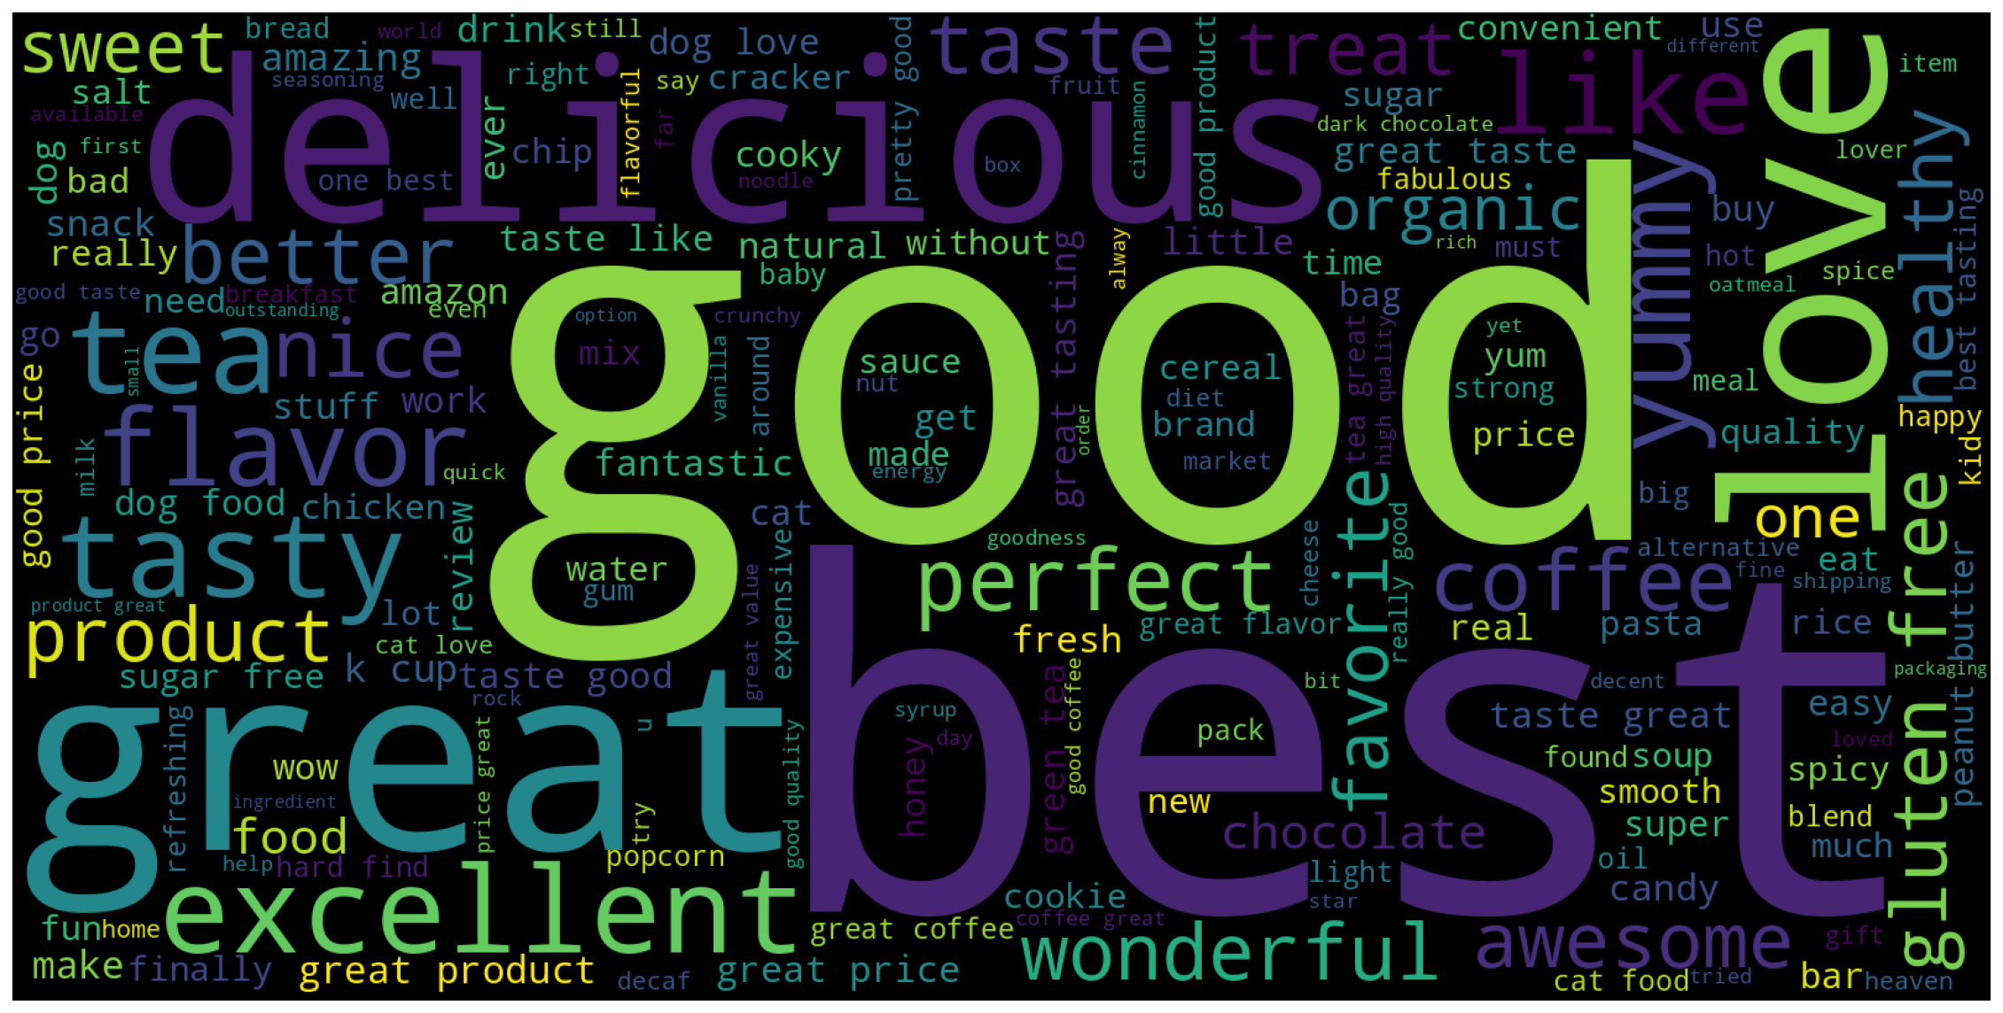
Positive Review Text

Slide 13
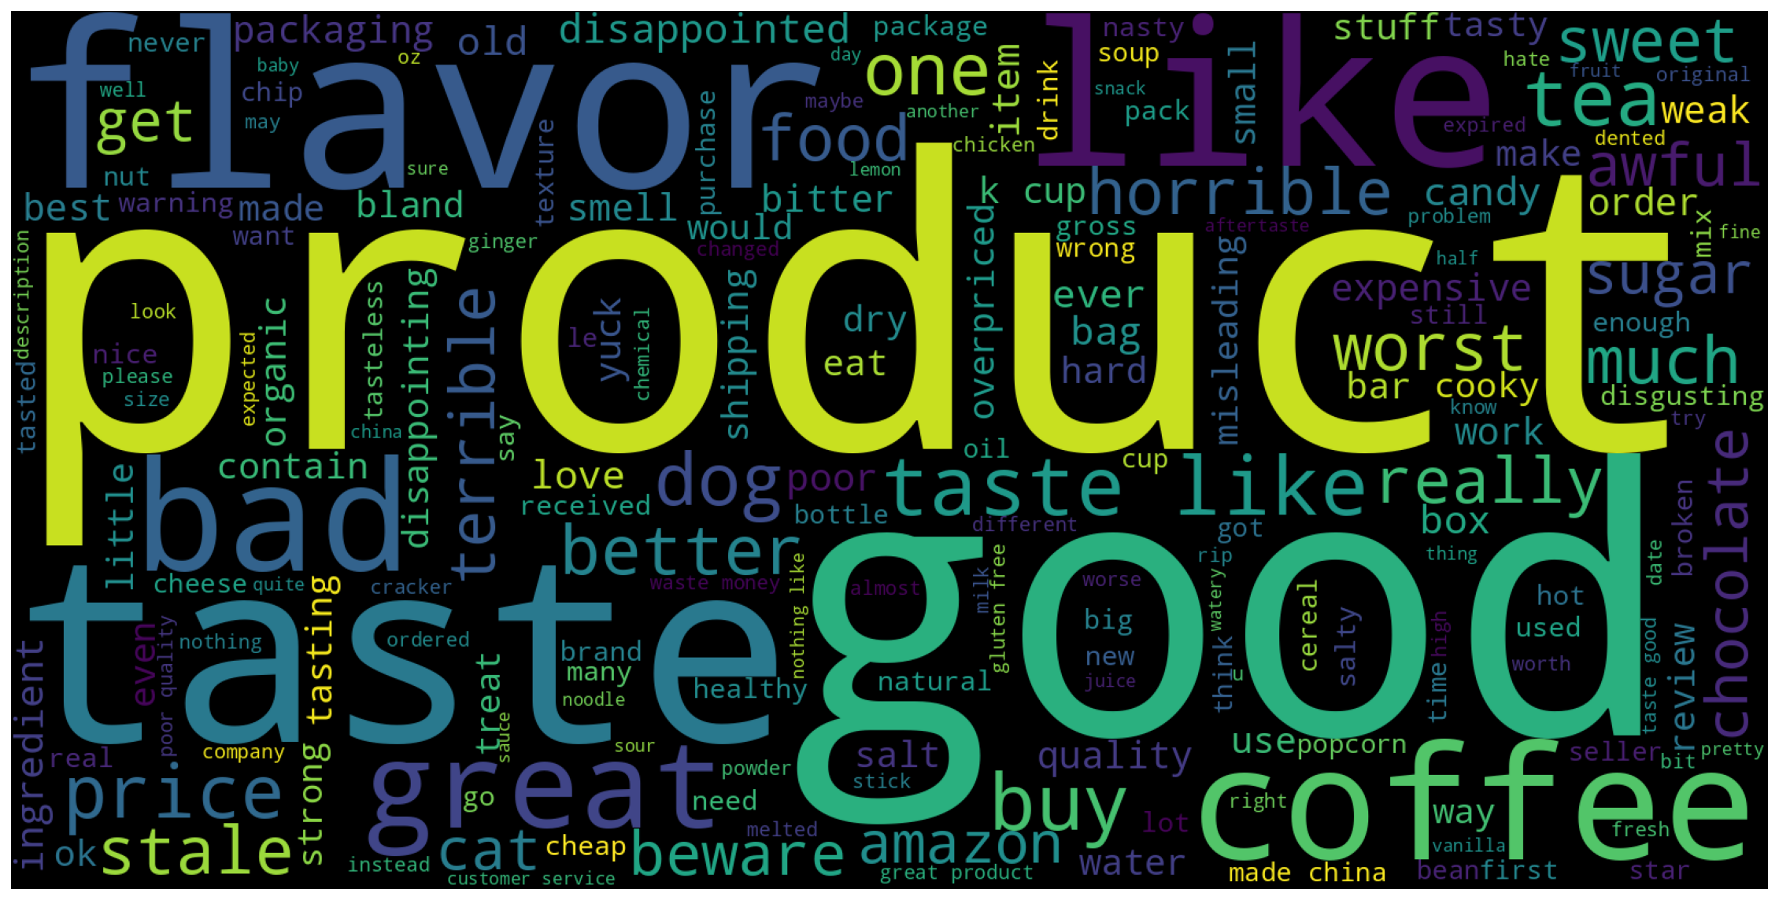
Negative Review Text

Slide 14
Conversion of Text to Numerical vectors
Bag Of Words Representation
Import sklearn
Import CountVectorizer
Creation of object for CountVectorizer
Applying fit_transform on X_train Data
Applying transform on X_test Data
Number of unique words found = 61,866

Slide 15
MODEL BUILDING
Logistic Regression
K-Nearest Neighbors Classifier
Decision Tree Classifier
Random Forest Classifier
Gradient Boosting Classifier
ADA Boost Classifier

Slide 16
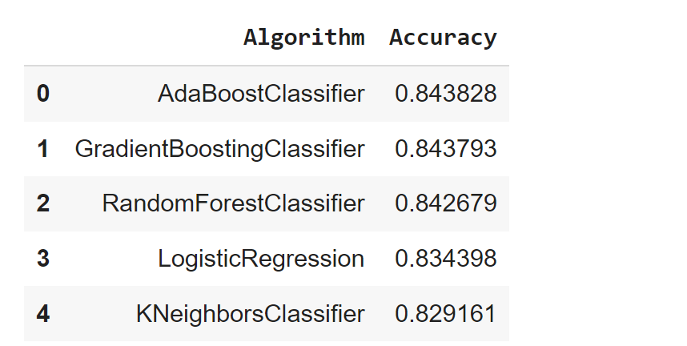
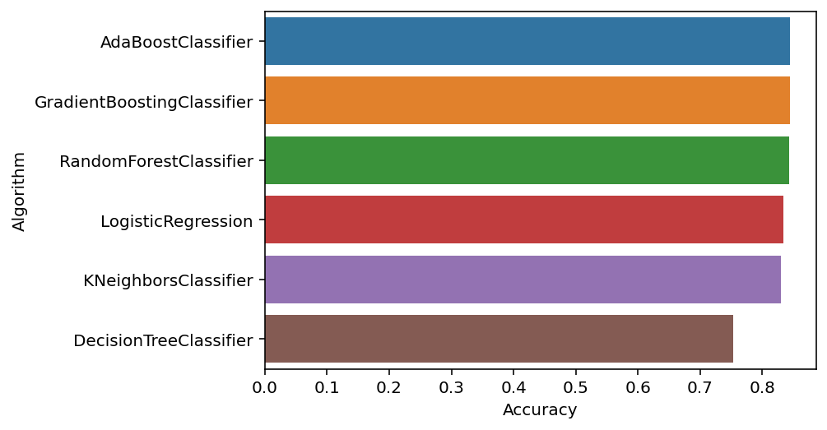
EVALUATION

Slide 17
CONCLUSIONS
Maximum accuracy : Ada Boost Classifier Algorithm.
Only minor differences were observed in the accuracy scores of Ada Boost Classifier, Gradient Boosting Classifier and Random Forest Classifier Algorithms.
A mild imbalance of data was observed
Many common words were found in both positively reviewed and negatively reviewed WordCloud Images.

Slide 18

THANK YOU
For your patience & Time

